Slide 1
Comparative analysis: U.S. Craft Beers

Slide 2
Breweries by State
States with highest number of breweries
Colorado
California
Michigan
Oregon
Texas
States with the lowest number of breweries
Arizona
West Virginia
South Dakota
North Dakota
Washington D.C.

Slide 3
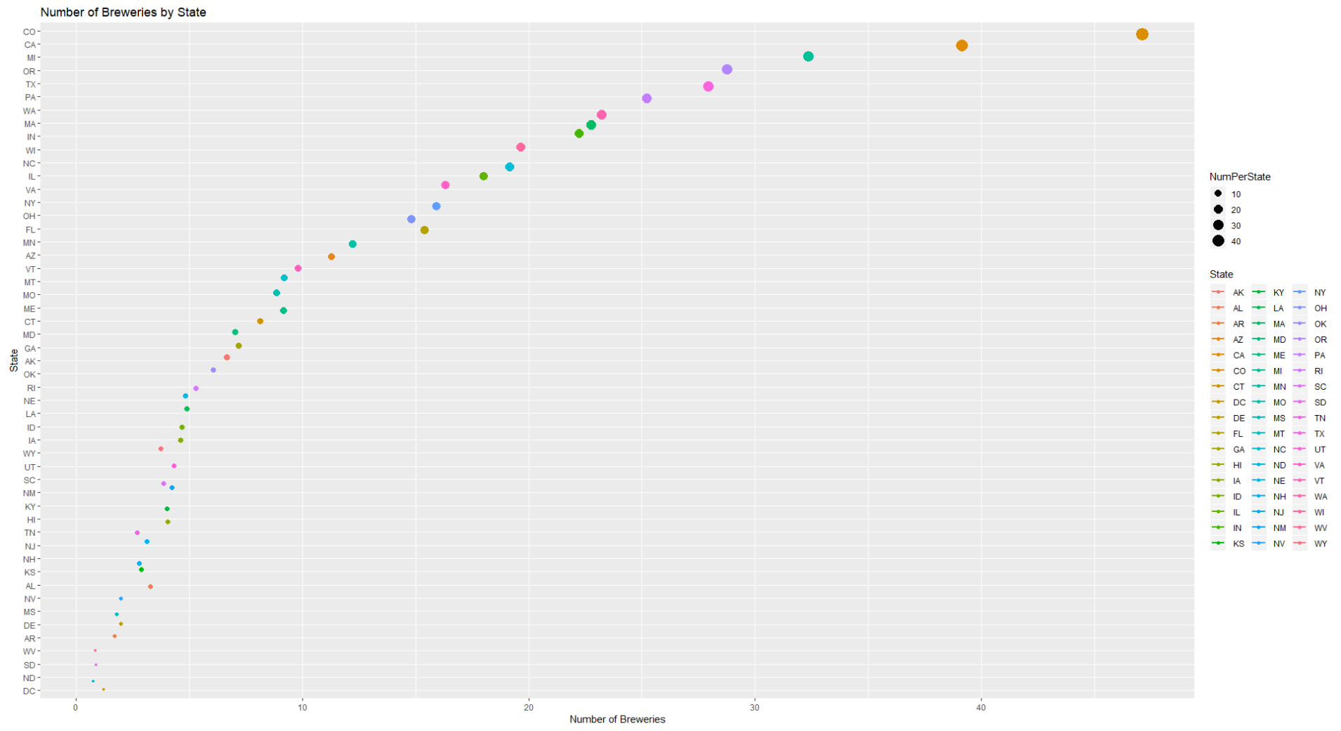

Slide 4
Top and Bottom Brewery and Beer
Top 6
Brewery Name | City | State | Beer Name | ABV | IBU | Style | Ounces
NorthGate Brewing | Minneapolis | MN | Pumpion | 0.06 | 38 | Pumpkin Ale | 16
NorthGate Brewing | Minneapolis | MN | Stronghold | 0.06 | 25 | American Porter | 16
NorthGate Brewing | Minneapolis | MN | Parapet ESB | 0.056 | 47 | Extra Special / Strong Bitter (ESB) | 16
NorthGate Brewing | Minneapolis | MN | Get Together | 0.045 | 50 | American IPA | 16
NorthGate Brewing | Minneapolis | MN | Maggie's Leap | 0.049 | 26 | Milk / Sweet Stout | 16
NorthGate Brewing | Minneapolis | MN | Wall's End | 0.048 | 19 | English Brown Ale | 16
Bottom 6
Brewery Name | City | State | Beer Name | ABV | IBU | Style | Ounces
Ukiah Brewing | Ukiah | CA | Pilsner Ukiah | 0.055 | NA | German Pilsener | 12
Butternuts Beer and Ale Garrattsville | Garrattsville | NY | Porkslap Pale Ale | 0.043 | NA | Ameracan Pale Ale (APA) | 12
Butternuts Beer and Ale Garrattsville | Garrattsville | NY | Snapperhead IPA | 0.068 | NA | American IPA | 12
Butternuts Beer and Ale Garrattsville | Garrattsville | NY | Moo Thunder Stout | 0.049 | NA | Milk / Sweet Stout | 12
Butternuts Beer and Ale Garrattsville | Garrattsville | NY | Heinnieweisse Weissebier | 0.049 | NA | Hefeweizen | 12
Sleeping Lady Brewing Company | Anchorage | AK | Urban Wilderness Pale Ale | 0.049 | NA | English Pale Ale | 12

Slide 5
Report on NA values
The data set shows the following columns with the number of NA values:
ABV: 62 values
IBU: 1005 values
These values are null values and not “Not Applicable” values

Slide 6
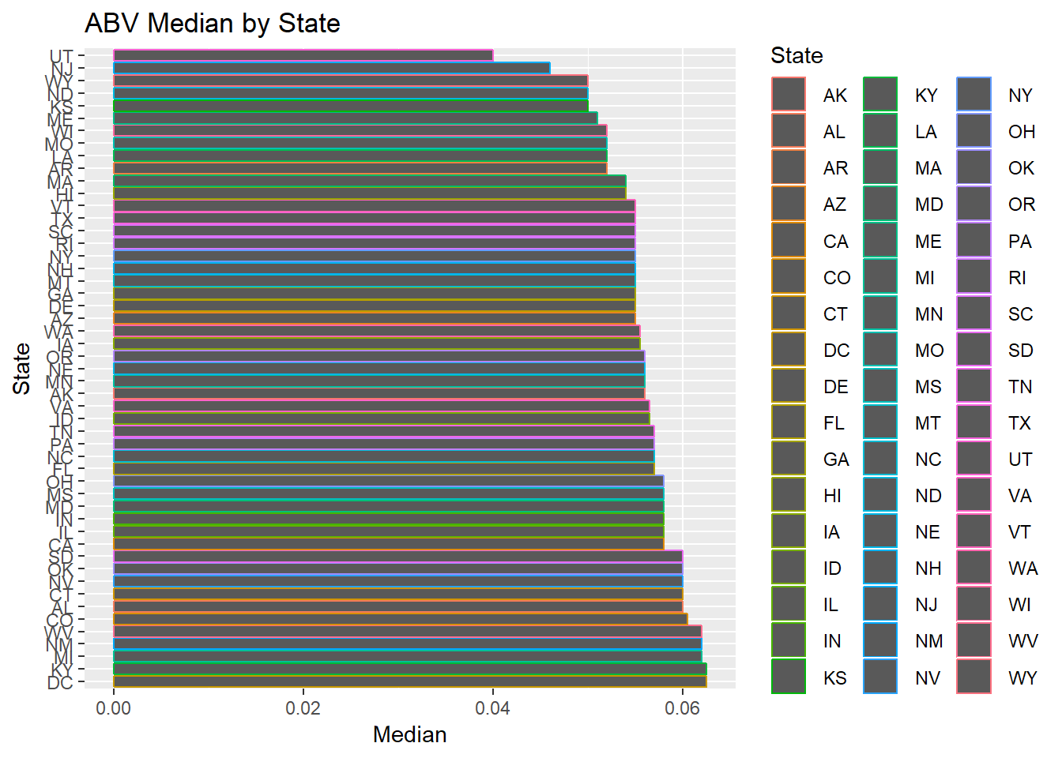
ABV Median by State
States with the highest alcoholic beer:
Kentucky and Washington DC
6.25% ABV

Slide 7
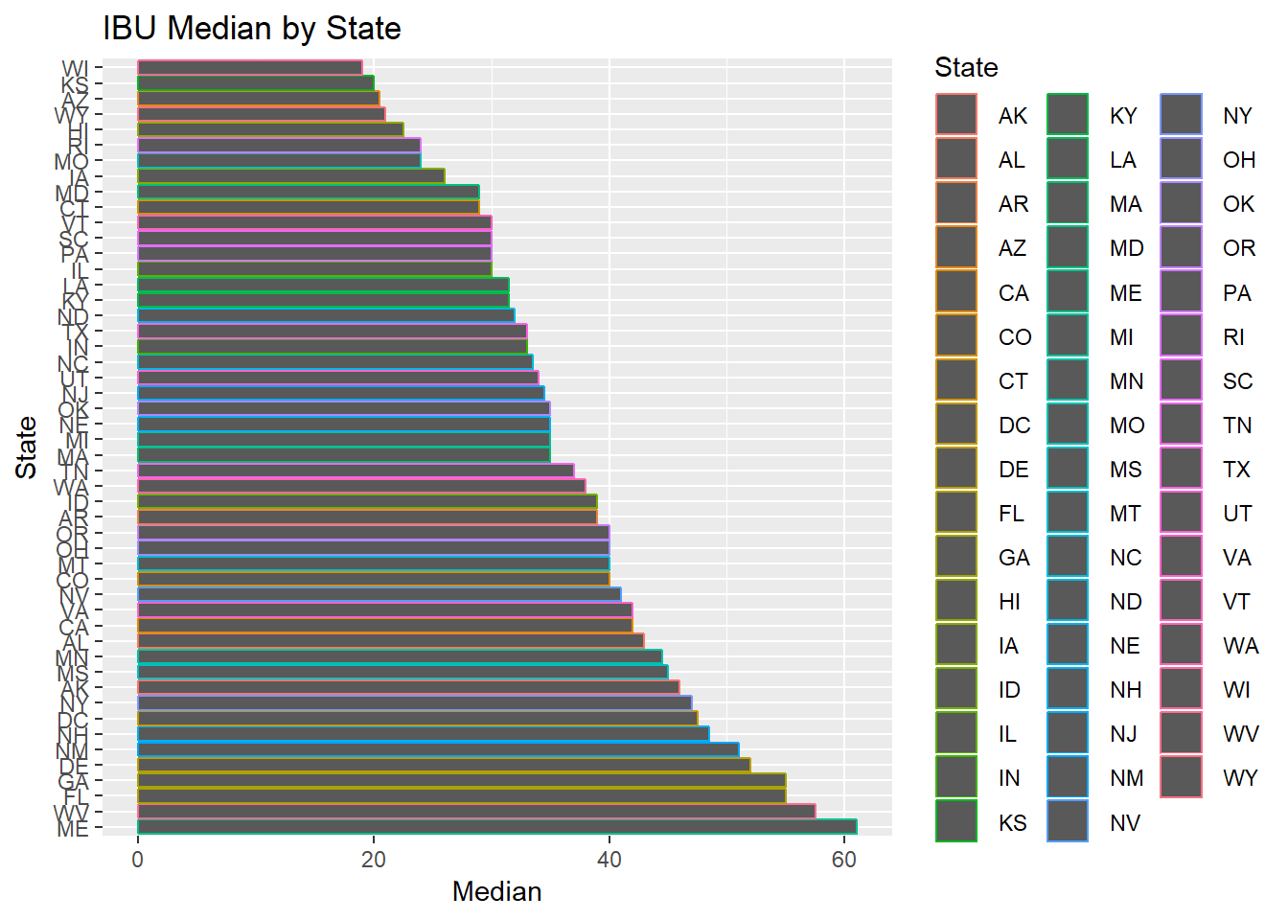
IBU Median by State
State that has the most bitter beer:
Maine
61 IBU

Slide 8
Alcohol by volume summary
Mean of 0.0598
Median of 0.067
Minimum of 0.001
Maximum of 0.128

Slide 9
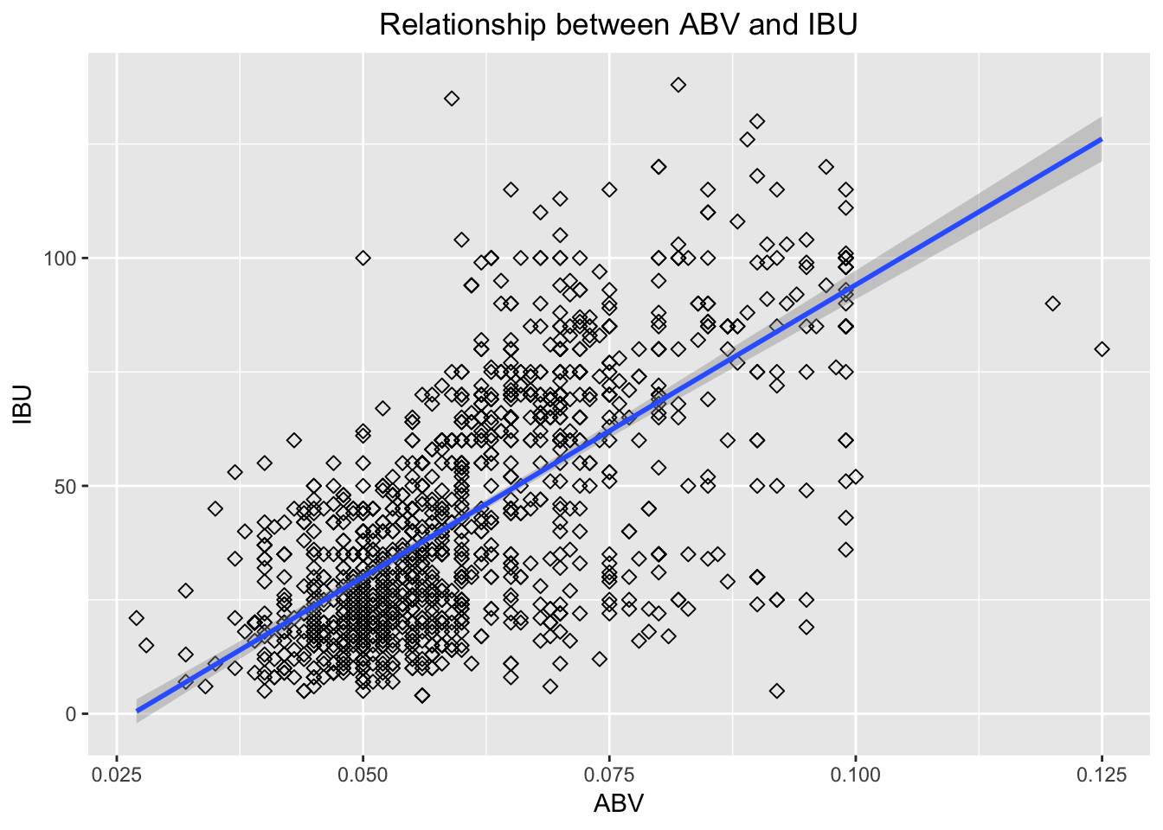
Relationship between abv and ibu

Slide 10
Thank you
Any questions?

